Slide 1

KNIT KART Fostering Sustainable Practices and Community Engagement
Major Project under the guidance of Prof. Babu Ram Prof. Sonam Arya
Submitted by:- Arshil Amaan Ansari (22709) Rahul Saini (22742)
Rakesh Kumar (22743) Shantanu Saini (22751)
Kamla Nehru Institute of Technology
14/May/2024

Slide 2
Introduction to KNIT KART
Technologies Utilized
MongoDB: NoSQL database for efficient data storage. Express.js: Backend framework for streamlined server-side logic. React.js: Frontend library for interactive user interfaces. Node.js: Runtime environment for scalable backend code. This stack enables fast development, real-time updates, and seamless frontend-backend communication.
Motivation: Driven by the observed surplus of valuable yet unused items in hostels, KNIT KART aims to reduce waste and promote a more sustainable lifestyle.
Problem: Hostels face challenges in efficiently facilitating item exchanges, with existing platforms focusing on monetary transactions rather than community needs.
Objective: KNIT KART addresses surplus and underutilization of items in hostel environments by promoting item exchanges and fostering sustainability.
Solution: KNIT KART fills this gap by encouraging direct swaps, fostering community engagement, and promoting responsible consumption practices.
Introduction to KNIT KART

Slide 3
System Design
Proposed System:
Modern and scalable architecture for KNIT KART.
Addresses challenges in traditional platforms.
Fosters sustainable and collaborative living.
Key Components:
Frontend: React.js, styled-components, Modular design.
Backend: Node.js, Express.js, MongoDB.
Authentication: JWT, bcrypt.
Scalability and Deployment:
Hosted on Vercel.
Cloud-based MongoDB Atlas.
System Features:
User Profiles and Listings.
Item Exchanges and Transactions.
Community Interaction.
Design Considerations:
Responsive design principles.
Modular and maintainable codebase.
* From next page you’ll see a glimpse of UI of KNIT KART

Slide 4
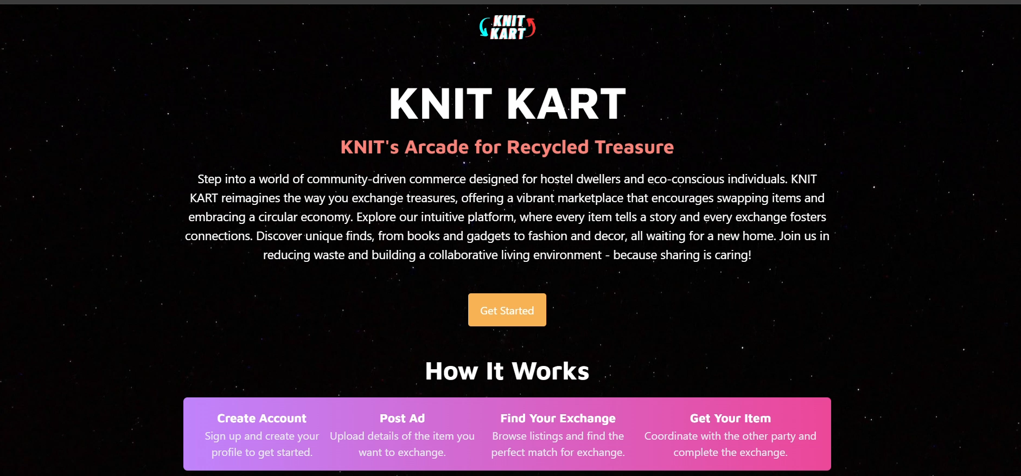
Landing Page

Slide 5
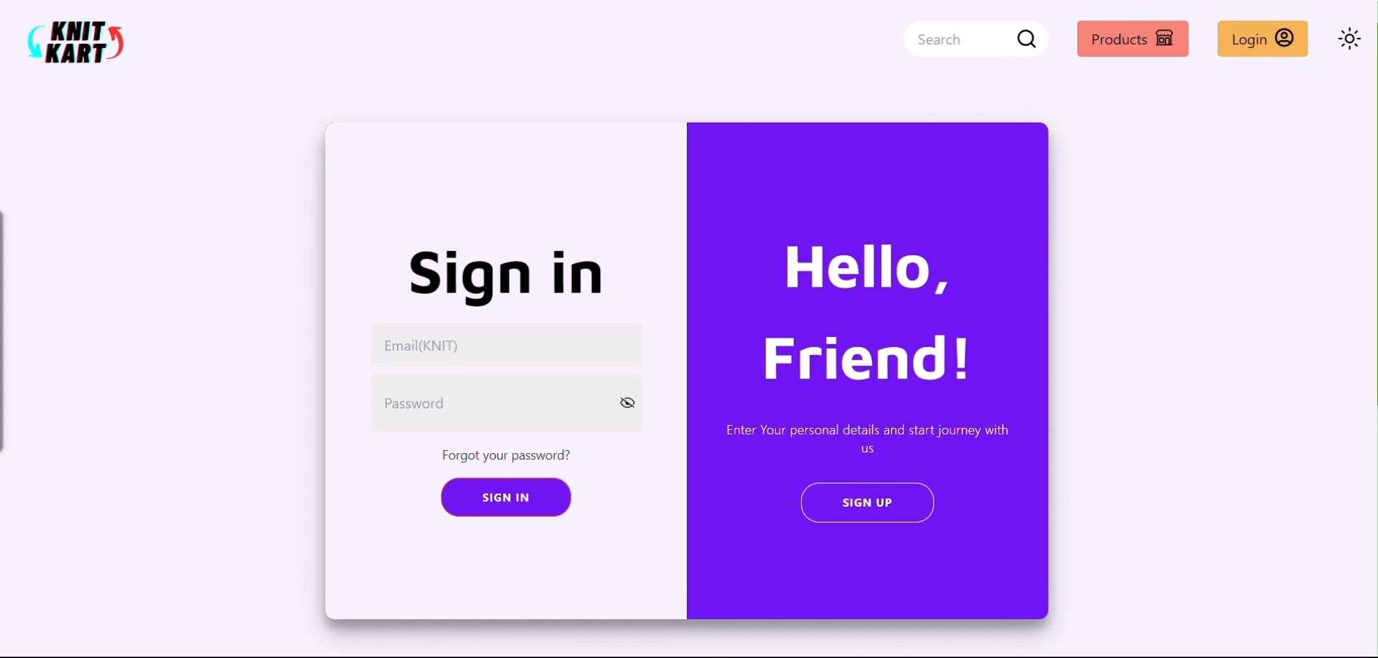
Dynamic Sign Up/Sign In Experience: A Visual Journey

Slide 6
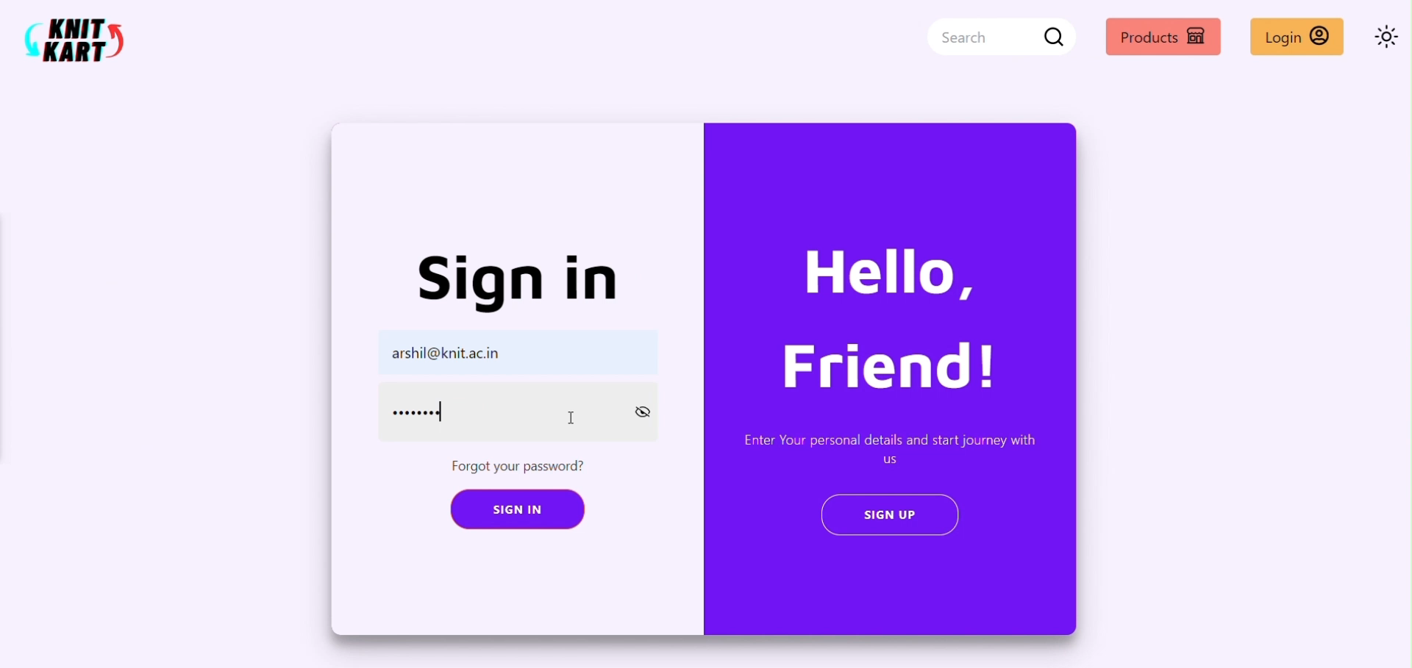
Home Page & Post Ad

Slide 7
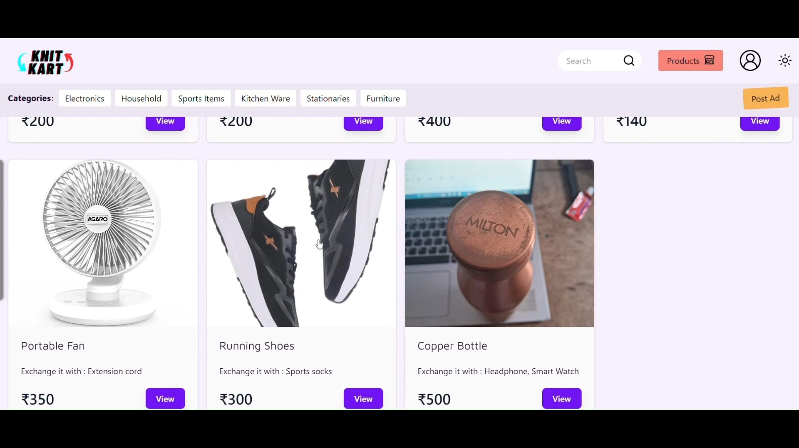
Product Page

Slide 8
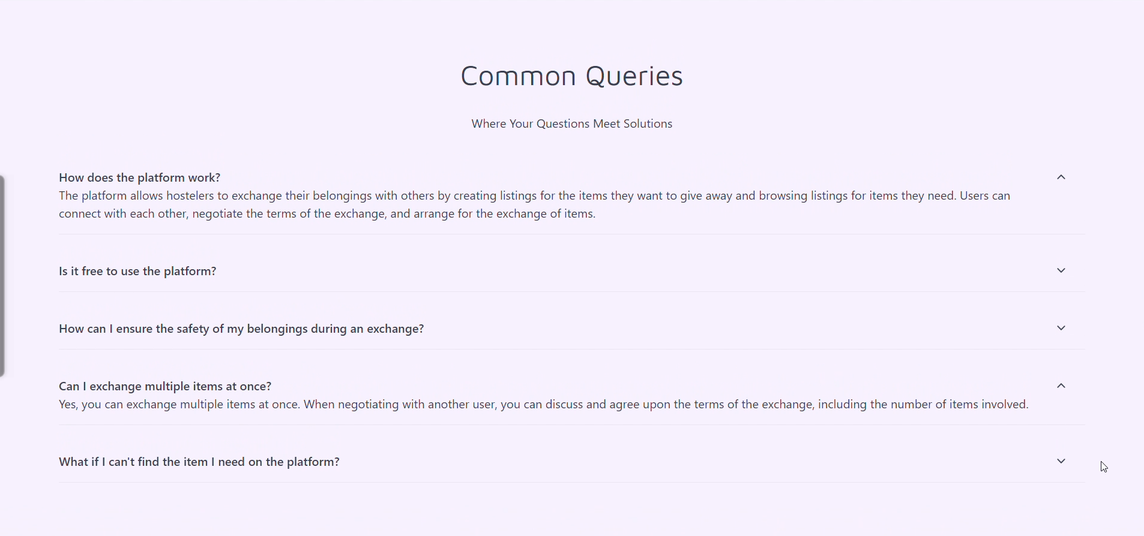
Queries Section

Slide 9
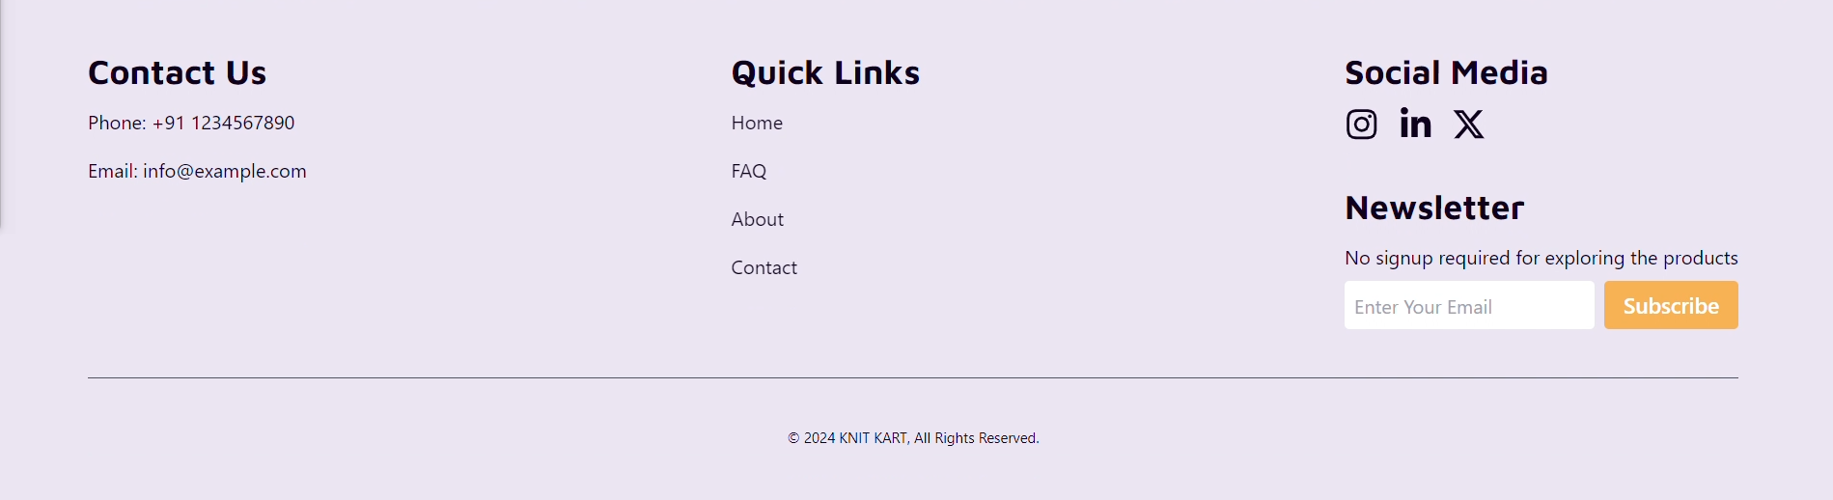
Footer

Slide 10
Literature Survey & System Requirements
Literature Survey
Software Requirements
Methodologies:
Review of popular online marketplaces.
Study of circular economy principles.
Research on community engagement strategies.
Key Findings:
Platforms focus on monetary transactions, missing direct swaps' potential.
Circular economy principles encourage waste reduction and resourceful interactions.
Community engagement is vital for trust and meaningful interactions.
Software Requirements:
Front-end: React.js, Tailwind CSS.
Back-end: Node.js, Express.js, MongoDB.
Tools: Git, Visual Studio Code, Postman.
Functional Requirements:
User Registration and Authentication, Item Listing and Management, Item Search and Exchange , Notification and Messaging
Non-functional Requirements:
Performance and Scalability, Security and Reliability, Usability and Accessibility, Interoperability and Maintainability
Hardware Requirements:
Server: CPU, RAM, Storage, Cloud Hosting: AWS, Vercel, Client-side: Display, Modern Web Browsers

Slide 11
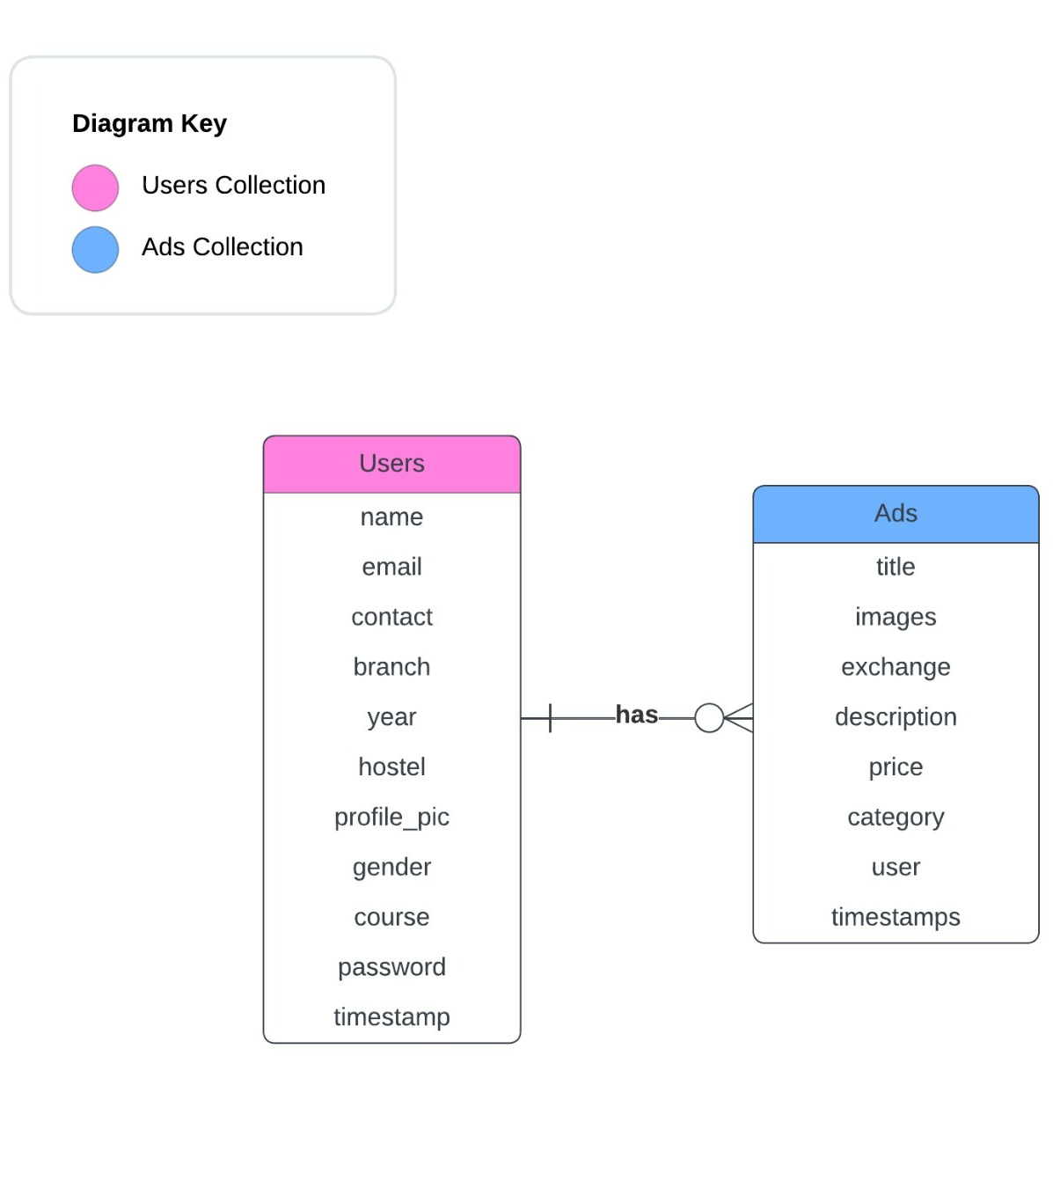
ER Diagram

Slide 12
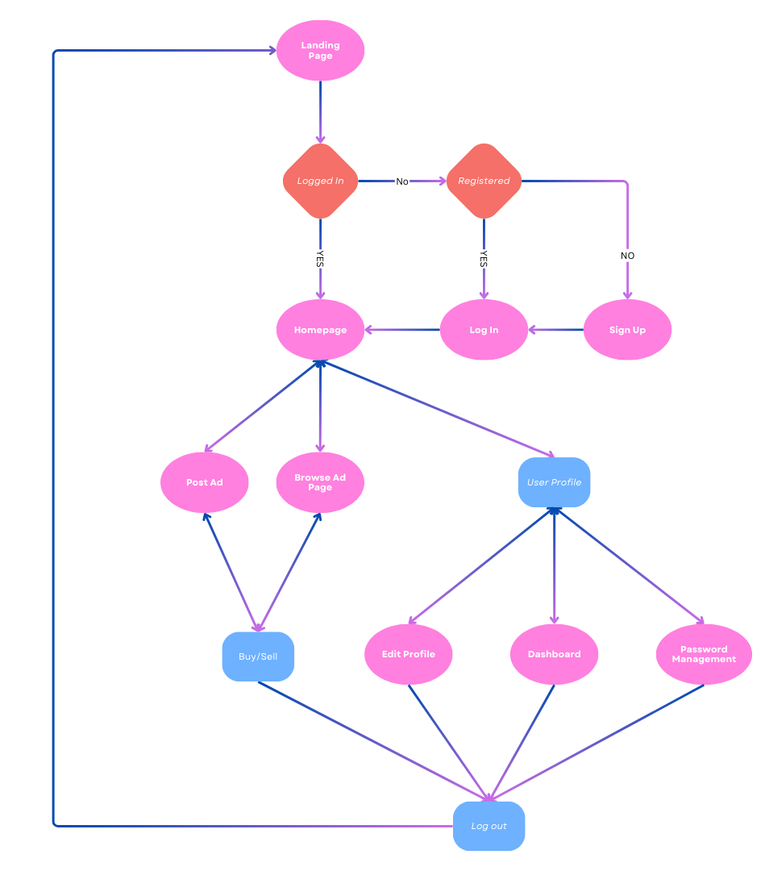
Flow Chart

Slide 13
Conclusion
KNIT KART has successfully addressed challenges in hostel communities, promoting sustainability and collaboration through item exchanges. Key outcomes include:
Unique Challenges Addressed: KNIT KART tackles surplus item issues in hostels, promoting a circular economy.
Community Engagement: Encourages direct item exchanges, fostering trust and camaraderie.
Technological Advancements: Utilizes modern technologies for an intuitive user experience.
Sustainability Impact: Reduces waste and promotes resourceful exchanges, contributing to sustainability.
Looking ahead, KNIT KART aims for further expansion and impact beyond hostels, focusing on user adoption and platform refinement.

Slide 14
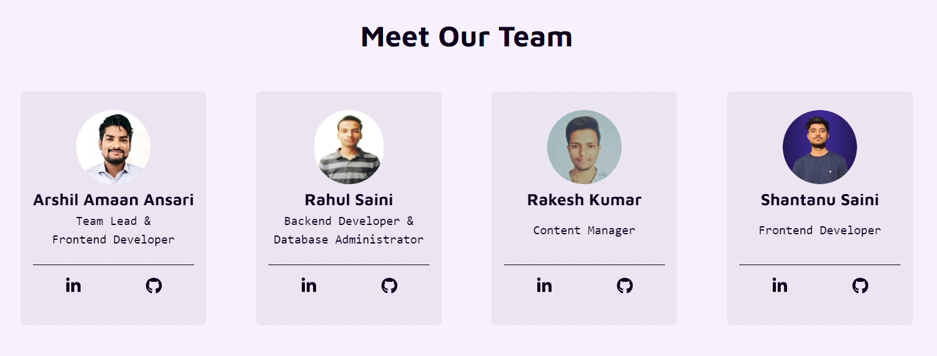
Embark on a Sustainable Journey with KNIT KART. Thank you for joining us in promoting sustainability and fostering collaboration within hostel communities.
Thank You
“
”

